Slide 1

Sales Optimization Analysis
K NITHINRAM
Lakshmi Narayana Arts and Science College, Kerala
B.Sc. Computer Science 2023 graduate
AICTE ID/Apply ID: APPLY_172684756366ed9a4b66be3

Slide 2

PROBLEM STATEMENT
Optimizing the Superstore dataset in its business operations by understanding sales patterns, profitability across different regions, categories, and customer segment performance to make data-driven decisions for improving business efficiency and profitability.

Slide 3
Project Description The SuperStore Data Analysis examines sales data from a Superstore, focusing on:
Regional sales and profits distribution Category-wise sales and profits distribution.
Customer segment analysis.
Impact of discounts on profits
Overall business performance metrics

Slide 4
About the dataset
The dataset contains 9994 rows and 13 columns of data.
The dataset features are Ship Mode, Segment,
Country, City, State, Postal Code, Region, Category, Discount, and Profit. It comprised of only sales and profits data of only one country i.e., United States and it does cover all states through out South, West, Central, and East regions of the nation. The postal code column was dropped since it did not contribute much to our objective.
The type of ship modes are: Second Class, Standard Class, First class, and Same Day.
The Segment types are: 'Consumer' 'Corporate' 'Home Office’.
The Product categories are: 'Furniture' 'Office Supplies' 'Technology'. and their sub-categories are: 'Bookcases' 'Chairs' 'Labels' 'Tables' 'Storage' 'Furnishings' 'Art' 'Phones' 'Binders' 'Appliances' 'Paper' 'Accessories' 'Envelopes' 'Fasteners' 'Supplies' 'Machines' 'Copiers'.

Slide 5

WHO ARE THE END USERS?
Store managers and administrators
Sales team
Marketing department
Business strategists
Category managers

Slide 6
Technology Used
Programming Language: Python
Libraries: NumPy, Pandas, Matplotlib, Seaborn
IDE: Google Colab

Slide 7
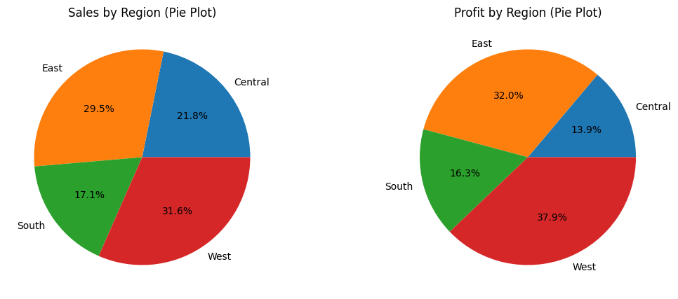
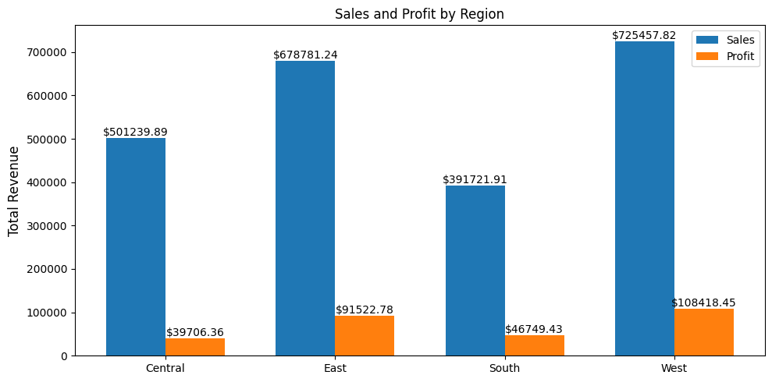
RESULTS – Sales and Profits by Region
We see that Eastern and Western regions has the most sales followed by Central and South. Out of which Western region makes 31.6% percent out of total sales making it the leading region in sales.
Here in Profits by Region we can see that Western region makes the most profits i.e., 37.9% out of total profits followed by Eastern region with 32% of profits. But the key point to notice is that although Central region was top 3rd sales maker but it falls behind in making profits.
As Central region made more sales than Southern region but made less profits than Southern region, this difference has to be closely observed further.
Demo Link

Slide 8
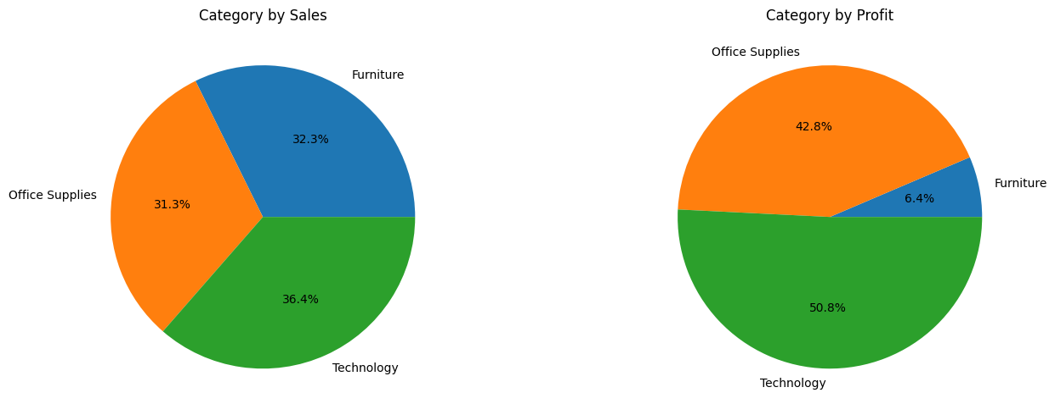
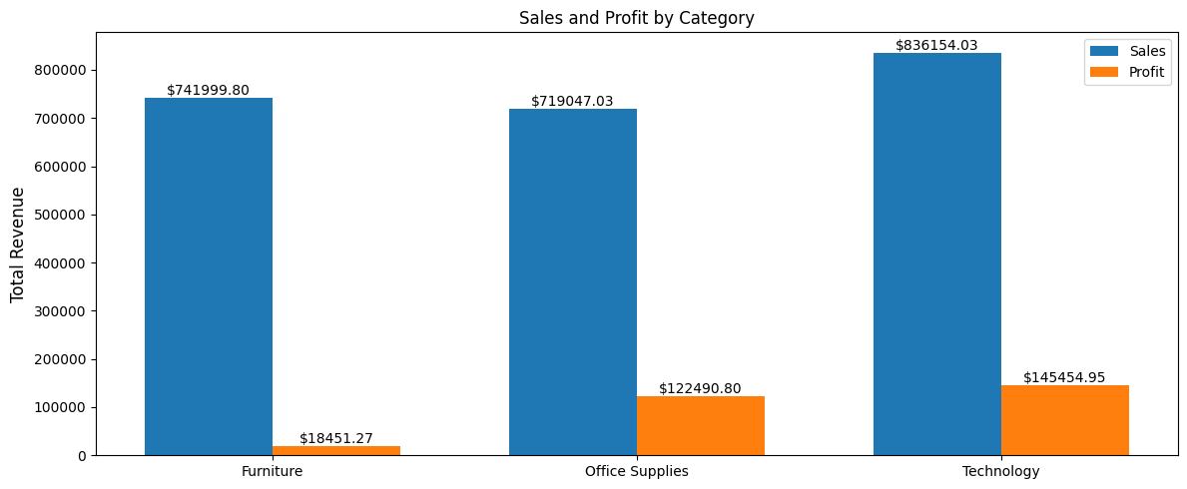
RESULTS – Sales and Profits by Category
We can observe that technology category products has the most 836154.03$ sales and 145454.95$ profits followed by office supplies and furniture in profits, but in sales all three categories has almost the same percentage in sales.
Demo Link

Slide 9
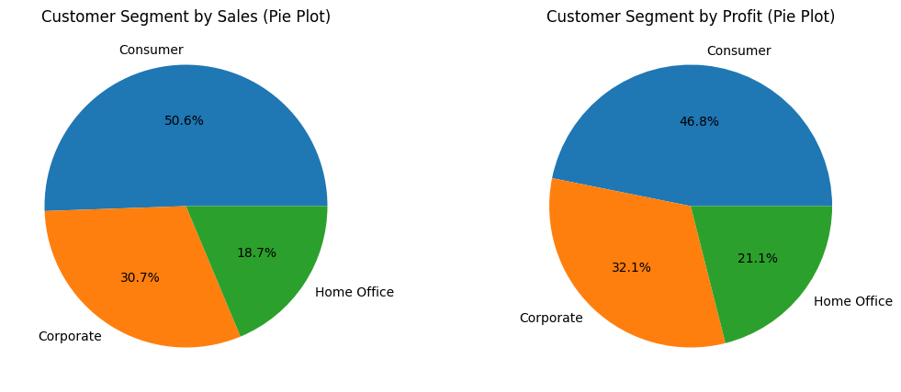
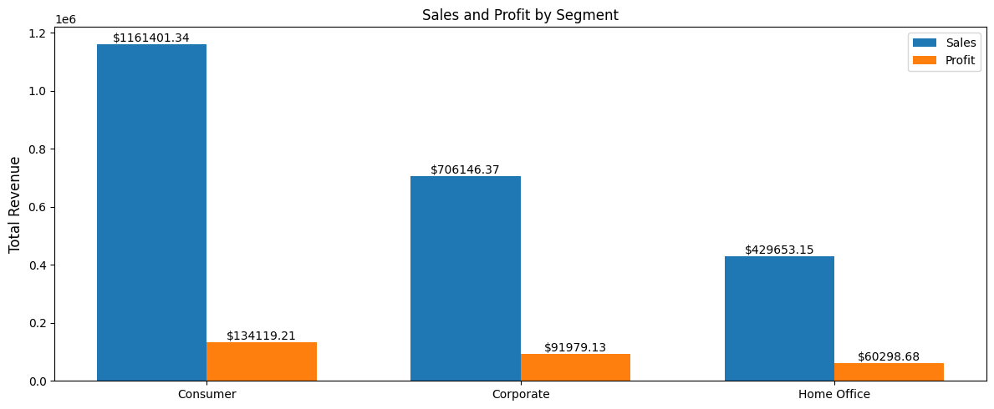
RESULTS – Sales and Profits by Customer Segment
The Consumer Segment customers are notably the most involved in sales with 50.6% of total sales followed by Corporate with 30.7% and Home Office with 18.7% of total sales.
Similarly to Sales Consumer Segment customers contributes to the most profit with 46.8% out of total profits, followed by Corporate customers with 32.1% and Home Offices Segment customers with 21.2% profits.
Demo Link

Slide 10
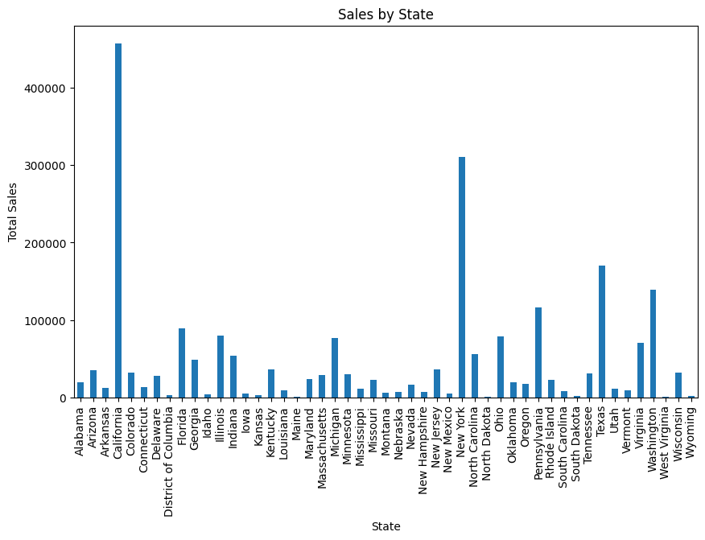
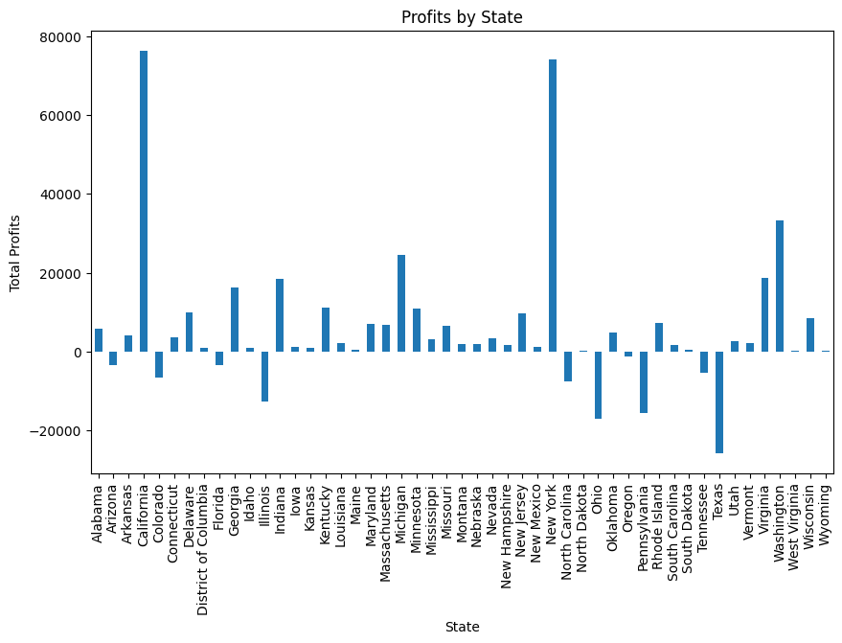
RESULTS – Sales and Profits by States
In terms of Sales of Profits with respect to various states of the country, California and New York are the best performers and Texas makes the least profits
Demo Link

Slide 11
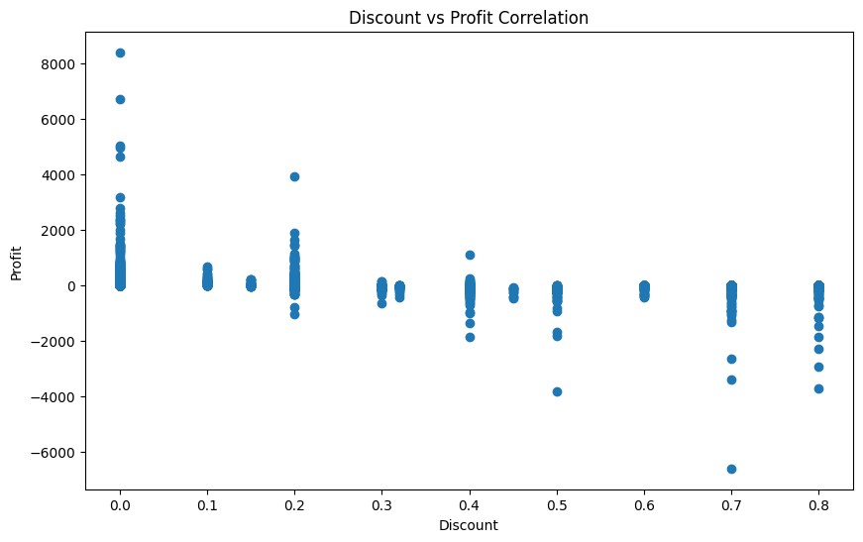
RESULTS – Discount vs Profit Correlation
There's a negative correlation between discounts and profits, suggesting careful discount strategy is needed The overall profit margin was 12.47% indicating suggestions or improvements and strategic decisions
Demo Link

Slide 12
Conclusion
Key Performance Metrices
Total Sales | $ 2297200.86
Total Profits | $ 286397.02
Profit Margin | 12.47 %
Total Orders | 9994
Technology is the highest-performing category with sales of $836,154, followed by Furniture and Office Supplies Consumer Customer Segment leads in sales ($1,161,401), representing about 50% of total sales
There's a negative correlation between discounts and profits, suggesting careful discount strategy is needed The overall profit margin of 12.47% indicates room for improvement in operational efficiency.
Top Performing Categories by Sale
Technology | $836154.03
Furniture | $741999.80
Office Supplies | $719047.03
Customer Segment-wise Sales Performance
Consumer | $1161401.34
Corporate | $706146.37
Home Office | $429653.15

Slide 13
Thank you
My Sincere Gratitude to Connecting Dreams Foundation and Vodafone _VOICE for tech for providing the dataset and resources.
K NITHINRAM
Lakshmi Narayana Arts and Science College, Kerala
B.Sc. Computer Science 2023 graduate
AICTE ID/Apply ID: APPLY_172684756366ed9a4b66be3
.
.

